Slide 1
Pipeline II
Hazards

Slide 2
Real World Analogy:: Resources Hazard
There are three different types of hazard relate to pipelining one of these hazards is explained using Car Manufacture pipeline example.
Assume that we one have one employee that assembles and paints the car as well.
LHS table shows the ideal case, but there is a conflict of resource here, P and A cannot be done at same time.
This is called resource hazard with one object cannot proceed in pipeline because the resource need by it is busy with other object.
RHS table show that one solution can be that car 2 waits for A until P of car1 is complete (Car 3 waits for A till P of Car 2 is complete)
Another solution can be to add more resources, in this case hire another employee for paint job
Time line | 1st hour | 2nd hour | 3rd hour | 4th hour | 5th hour
Car 1 | A | P | T
Car 2 |  | A | P | T
Car 3 |  |  | A | P | T
Time line | 1st hour | 2nd hour | 3rd hour | 4th hour | 5th hour | 6th hour | 7th hour
Car 1 | A | P | T
Car 2 |  | idle | A | P | T
Car 3 |  |  |  | idle | A | P | T

Slide 3
Pipeline Hazard in Computer
A pipeline hazard occurs when the pipeline, or some portion of the pipeline, must stall because conditions do not permit continued execution.
Such a pipeline stall is also referred to as a pipeline bubble.
Three Hazard types:
Structural/Resource
same resource is needed multiple times in the same cycle
Data
Instruction depends on result of prior instruction still in the pipeline data dependencies limit pipelining
Control
Next executed instruction may not be the next specified instruction

Slide 4
Pipeline Hazard in Computer
Can always resolve hazards by stalling
More stall cycles = more CPU time = less performance
Increase performance = decrease stall cycles

Slide 5
Structural/Resource Hazard
A resource hazard occurs when two (or more) instructions that are already in the pipeline need the same resource.
The result is that the instructions must be executed in serial rather than parallel for a portion of the pipeline.
Examples:
Two accesses to a single ported memory
Two operations need the same function unit at the same time
Two operations need the same function unit in successive cycles, but the unit is not pipelined
Solutions:
stalling
add more hardware

Slide 6
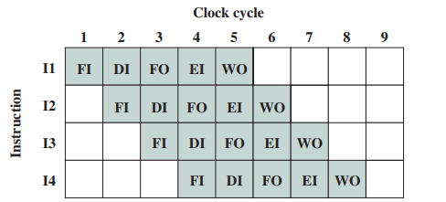
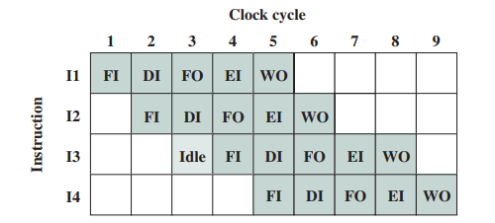
Structural/Resource Hazard:: Example
Assume the there is only single port to memory
FO of I1 and FI of I3, both require reading from memory at cycle 3
Assume that for operand for rest of the Instructions are registers.
There resource conflict between I1 and I3
I3 must wait

Slide 7
Data Hazards
Data hazards occur when the pipeline changes the order of read/write accesses to operands so that the order differs from the order seen by sequentially executing instructions on an unpipelined processor.
Three types of data dependencies defined in terms of how succeeding instruction depends on preceding instruction
RAW: Read after Write or Flow dependency
WAR: Write after Read or anti-dependency
WAW: Write after Write

Slide 8
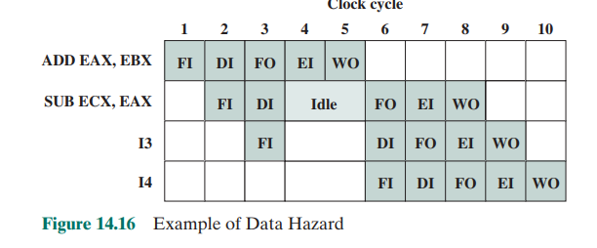
RAW
Read After Write (RAW) Instr_{J} tries to read operand before Instr_{I} writes it
I: ADD AX, BX
J: SUB CX, AX

Slide 9
Write after read (WAR) or antidependency
An instruction reads a register or memory location and a succeeding instruction writes to the location.
A hazard occurs if the write operation completes before the read operation takes place.
I: read from location X
J: write to location X
Incorrect answer if J finishes before I

Slide 10
Write after write (WAW), or output dependency
Two instructions both write to the same location.
A hazard occurs if the write operations take place in the reverse order of the intended sequence.
I: write to location X
J: write to location X
Incorrect answer if J finishes before I

Slide 11
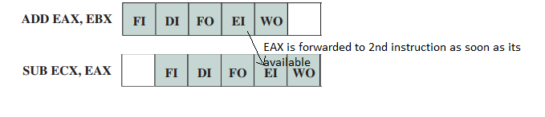
Data Hazard
Solution
Stalling
Logic Detection
Data Forwarding
Used in RAW dependency, data is forwarded to next instruction as soon as its available so that next instruction doesn’t have to wait for write operand
Needs changes in hardware

Slide 12
Control Hazard
A control hazard, also known as a branch hazard
Occurs when the pipeline makes the wrong decision on a branch prediction and therefore brings instructions into the pipeline that must subsequently be discarded

Slide 13
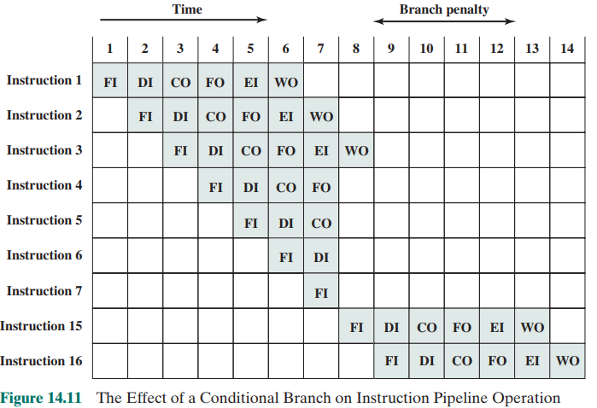
If instruction 3 was conditional branching
Until the instruction is actually executed, it is impossible to determine whether the branch will be taken or not.
If I3 takes jump to I15, all the work done for i4-i7 is wasted

Slide 14
Dealing with Branches
A variety of approaches have been taken for dealing with conditional branches
Multiple streams
Pre-fetch branch target
Loop buffer
Branch prediction
Delayed branch

Slide 15
Branch Prediction
■ Predict never taken
■ Predict always taken
■ Predict by opcode
■ Taken/not taken switch
■ Branch history table

Slide 16
Reference
Section 14.4 (Pipeline Hazards) from Computer Organization and Architecture Designing for Performance Tenth Edition, by William Stalling
http://www.cs.uni.edu/~fienup/cs240s05/lectures/lec5_1-25-05_web.htm
http://faculty.cse.tamu.edu/djimenez/614-spring14/bpred.html

